Slide 1
ICT Spreadsheets Lesson 3: Working with Formulas and Functions

Slide 2
Objectives – Lesson 3
8.3.3: Insert common formulas into a spreadsheet, including addition, subtraction, multiplication, division, subtotals, grand totals, text manipulations, etc.
8.3.4: Distinguish between absolute and relative cell references in a spreadsheet.
8.3.1: Identify various spreadsheet functions (i.e., preset formulas), including sum, average, count, maximum value, minimum value, etc.
8.3.2: Sum the numeric values of multiple cells.
8.3.5: Use conditional formatting to highlight text in a spreadsheet.

Slide 3
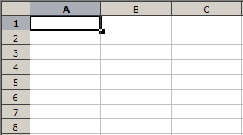
Performing Calculations
A spreadsheet can perform calculations just like your calculator.
However, you need to tell your spreadsheet all of details regarding what is to be calculated and how – by using a formula.
You will begin a formula with an equals (=).
After the equals, you enter the numbers or cell reference and operation (+, -, * or /) you want performed

Slide 4
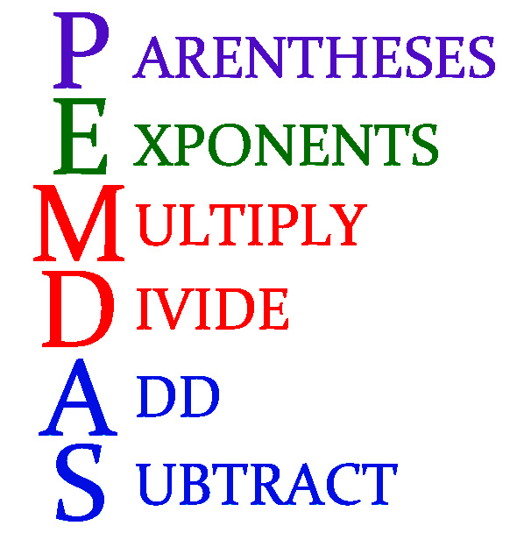
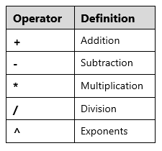
Performing Calculations
Cell references will update your calculations automatically if the values ever change.
Remember, to follow your PEMDAS order of operations when entering your formulas.

Slide 5
Using Common Spreadsheet Formulas
Once you enter a formula in a cell, you can use the Copy and Paste commands to quickly add the formula to other cells.
Relative means that the formula changes when it’s copied and pasted to a new location.
Absolute means that you don’t want the formula to change when you copy it to a new location.
Using the dollar sign ($) in front of each part of the cell reference will help it remain constant.
$A$1 Holds the entire cell reference constant.
$A1 Holds column A as a constant reference but changes the row number.
A$1 Holds row 1 as a constant reference but changes the column number.

Slide 6
Exploring Common Spreadsheet Functions
Your spreadsheet application contains functions that help simplify your formulas and calculate more complex formulas with greater ease.
Functions are preset formulas that are broken out into arguments or parts to make completing the function easier.
SUM function is used to add a range of cells.
=SUM([first cell]:[last cell]) –––– =SUM(C2:F2)
AVERAGE function will add together all the cells then divides the total by the number of cells in the range.
=AVERAGE ([first cell]:[last cell]) –––– =AVERAGE(C2:F2)

Slide 7
Let’s Watch the Video
How to use formulas in spreadsheets
Click Here
Notes:
Discuss types of connections – “Connecting to the Internet” video

Slide 8
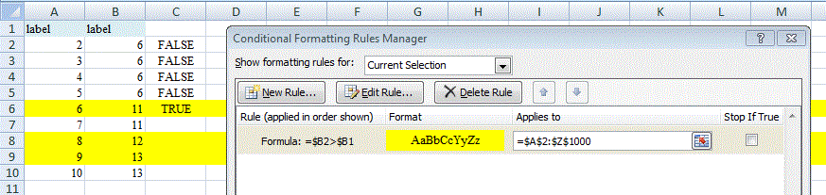
Working with Conditional Formatting
Conditional formatting looks at the cell content and tests it against a condition. If the results of the test are TRUE, formatting of your choice is applied
If row 2 of column $B ($ is constant) is > row 1 of column $B, then the formatting should be a yellow highlighted row (TRUE)

Slide 9
Let’s Watch the Video
How to use conditional formatting in spreadsheets
Click Here
Notes:
Discuss types of connections – “Connecting to the Internet” video

